Slide 1
Personalization
Presenter Name
Notes:
Information in this document, including URL and other Internet Web site references, is subject to change without notice. Unless otherwise noted, the example companies, organizations, products, domain names, e-mail addresses, logos, people, places, and events depicted herein are fictitious, and no association with any real company, organization, product, domain name, e-mail address, logo, person, place or event is intended or should be inferred. Complying with all applicable copyright laws is the responsibility of the user. Without limiting the rights under copyright, no part of this document may be reproduced, stored in or introduced into a retrieval system, or transmitted in any form or by any means (electronic, mechanical, photocopying, recording, or otherwise), or for any purpose, without the express written permission of Microsoft Corporation.
Microsoft may have patents, patent applications, trademarks, copyrights, or other intellectual property rights covering subject matter in this document. Except as expressly provided in any written license agreement from Microsoft, the furnishing of this document does not give you any license to these patents, trademarks, copyrights, or other intellectual property.
The names of manufacturers, products, or URLs are provided for informational purposes only and Microsoft makes no representations and warranties, either expressed, implied, or statutory, regarding these manufacturers or the use of the products with any Microsoft technologies. The inclusion of a manufacturer or product does not imply endorsement of Microsoft of the manufacturer or product. Links may be provided to third party sites. Such sites are not under the control of Microsoft and Microsoft is not responsible for the contents of any linked site or any link contained in a linked site, or any changes or updates to such sites. Microsoft is not responsible for webcasting or any other form of transmission received from any linked site. Microsoft is providing these links to you only as a convenience, and the inclusion of any link does not imply endorsement of Microsoft of the site or the products contained therein.
© 2017 Microsoft Corporation. All rights reserved.
Microsoft and the trademarks listed at https://www.microsoft.com/en-us/legal/intellectualproperty/Trademarks/Usage/General.aspx are trademarks of the Microsoft group of companies. All other trademarks are property of their respective owners.
August 2020

Slide 2
Abstract and learning objectives
In the whiteboard design session, you will work in groups to design a solution that should provide a vision that allows the audience (the Chief Marketing Officer, Chief Digital Officer, the Chief Data Officer, and the Customer Experience Manager) to understand how using this solution will give the information that is needed to deliver a personalization solution.
At the end of the whiteboard design session, you will be better able to design a solution that leverages various application and data services within Azure for an end-to-end architecture for Personalization.

Slide 3
Step 1: Review the customer case study
Outcome
Analyze your customer needs.
Timeframe
15 minutes

Slide 4
Customer abstract
Parts Unlimited, a subsidiary of Fabrikam Retail INC., has been feeling some pain and would like your help to redesign and implement some new solutions to be able to better compete in the current marketplace. Among the main problems that Parts Unlimited is facing are
* Lack of connection between online and in-store data leading to an inability to provide a selection optimization that is tailored to a specific customer
* Inconsistent pricing, promotion, product availability, and fulfillment strategies exist across their various channels
* Customers are not completing orders due to redundant steps in the shopping journey, and encountering irrelevant interactions with the system
* Currently, Parts Unlimited is unable to address latent customer needs
* Parts Unlimited is unable to deliver an engaging and compelling experience to their customers regardless of platform or location.
* Customer experiences vary when shopping across channels, including having fragmented and inconsistent experiences.
* Parts Unlimited currently is unable to maximize the effectiveness of their workforce.

Slide 5
Customer abstract continued
Parts Unlimited is asking you to deliver a solution that will allow their customers to experience a smooth and relevant experience, regardless of the platform, device, and/or channel from which they are shopping. Of great importance is the ability to deliver dynamic and rich content that includes augmented and mixed-reality experiences. Furthermore, customer data should be used to present relevant shopping experiences and product consistency to delight their customers.
Parts Unlimited wants to ensure that they have maximized their ad spend for increased ROI and increased revenue. Additionally, Parts Unlimited wants their customers to have an engaging experience that is similar on all digital channels and in their brick-and-mortar stores.
An additional piece of information Parts Unlimited would like is the ability to be able to optimize the utilization and effectiveness of their workforce.
In the end, your solution should provide a vision that allows the audience (the Chief Marketing Officer, Chief Digital Officer, the Chief Data Officer, and the Customer Experience Manager) to understand how using this solution will give the information that is needed to deliver a solid personalization experience for Parts Unlimited's users.

Slide 6
Customer situation
Parts Unlimited Retail, Inc has been selling goods through various retail channels for the past 15 years. As various platforms and technologies have evolved, Parts Unlimited has struggled to keep up, but has done the best they could to continue to provide solutions for their customers.
Currently, they have just over 200 brick-and-mortar stores but are planning to close 50+ of these stores next year, taking the number of physical locations down to 150 stores due to declining revenue and various other factors. Of the remaining 150 stores, 35 of them are currently streamlined for an attempted re-branding that happened a few years ago. The re-branded stores were chosen based on population bases of less than 50,000 in an 200 square mile radius or within 50 miles of a major metropolitan area. These rebranded "Parts Unlimited Hometown" stores eliminated most of the non-essential retail, such as sporting and workout equipment, and focused in on essentials like appliances, automotive, and kept a limited selection of electronics, only offering about 15% of the options for items like UHD televisions, antennas, and blu-ray players. Customers have expressed frustrations when an advertisement in the local newspaper for Parts Unlimited included a great deal on a large-screen television only to find they have to order online or drive to the larger store in a city that is sometimes located over 50 miles away. While it is clear that customers are not pleased with this solution, it is not clear if this is an effective strategy to save the company when it comes to providing a simplified retail option.

Slide 7
Customer situation continued
In addition to re-branding efforts, in the past few years attempts have been made to enhance the web app for responsive delivery and a couple of apps were also built to specifically target IOS and Android devices. Unfortunately, the data from these applications and the web solution is not connected, and when a user switches devices or goes from a device to the web, the experience is not uniform, leading to confusion and frustration. Questions such as "why isn't the item I selected on my phone in my cart when I go to the website?" are far too common.
Parts Unlimited needs an ability to collect and analyze all of this data in order to make the best uniform solution possible. The solution needs to allow for a user to be able to walk into a brick-and-mortar store and get the items they are looking for, or to be able to switch from any device to the web or from the web to a device and get a streamlined experience. Finally, the customer needs to leave the shopping experience as an advocate for the company, having been delivered an experience that they would recommend to others.

Slide 8
Current process
Parts Unlimited currently has over 200 brick-and-mortar stores, with 50+ stores closing and 35 stores running the re-branded profile. Some stores have a pre-determined, limited selection and a limited inventory of the products they do offer.
Parts Unlimited has an MVC website written in the .Net Framework and has been previously upgraded to version 4.7.2. The website is supposed to be responsive, as it utilized Bootstrap for responsive layout, but the site is currently not able to work on a few devices due to some styling problems.
In addition to the website, Parts Unlimited has an Android application written in native Java that is three versions behind the current version of Android, but has been upgraded enough to continue to work on newer devices, even though it does not necessarily leverage all of the features of newer devices.
Along with the website and android app, a third app written in Swift is available for use on the Apple IOS devices.
All applications and sites do work, but the user experience, including sign-on, shopping cart, and other factors is unique to each platform. For example, a user must sign in on the website and then sign in again on the device, and the shopping cart is not shared across devices, so items added to the cart on the web do not show up on the phone, or vice-versa.
As a struggling retailer, Parts Unlimited has a limited amount of resources to apply to getting the entire experience upgraded, so they need you to come up with the best, cost-effective solution.

Slide 9
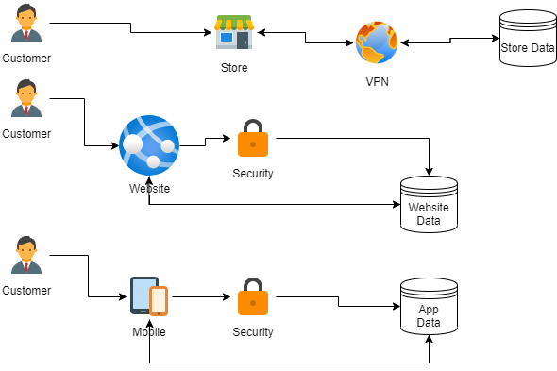
Current Process diagram

Slide 10
Customer Needs
1. Deliver a seamless experience to the user, regardless of platform, device, or location (online or at brick-and-mortar traditional stores). Current system uses multiple accounts and systems. Need to provide a complete 360 degree customer experience, making the customer experience relational, rather than transactional.
2. Use customer data to deliver a relevant shopping experience, including advertisements and product information based on the customer's search and shopping history.
3. Provide a customer experience on any delivery that provides dynamic and rich content. Content should leverage current trends and provide relevant cross-sell opportunities. Think "customers who bought W also liked X, Y, and Z." Also think "we know you, and we know you would like this too."
4. Ability to use machine learning and AI to create actionable, monetizable insights into customer patterns and industry trends.
5. Get customer satisfaction metrics and use those to be able to guide improvements. This could be in the form of surveys but would be nice if this included customer suggestions for improvement.
6. Customer data needs to be protected, and any governance needs to be easy to implement and effectively managed.
7. The solution needs to be robust and flexible to respond to market trends or other insights in the future.

Slide 11
Customer objections
1. Our customer experience is fine the way it is. We currently have good reviews online. Calls to the customer service line are answered quickly and effectively. Isn't there a better way to spend our limited resources of time and money?
2. Our customer loyalty is very high - it's why we are able to stay in business this long. Will this hurt our customer loyalty or our brand image?
3. How do we ensure that the customer data we are tracking and keeping is not violating any privacy laws? Our concern here is that if we are breached, we could be facing a very serious lawsuit.
4. How will using this solution provide the ability to offer products a customer might like? I am certain that our retail workers know their customers better than any algorithm ever could.
5. It is hard to believe that the insights generated by this solution will be able to provide better marketing campaign ideas and targets than our seasoned marketing team that knows who our customers are and what they like.

Slide 12
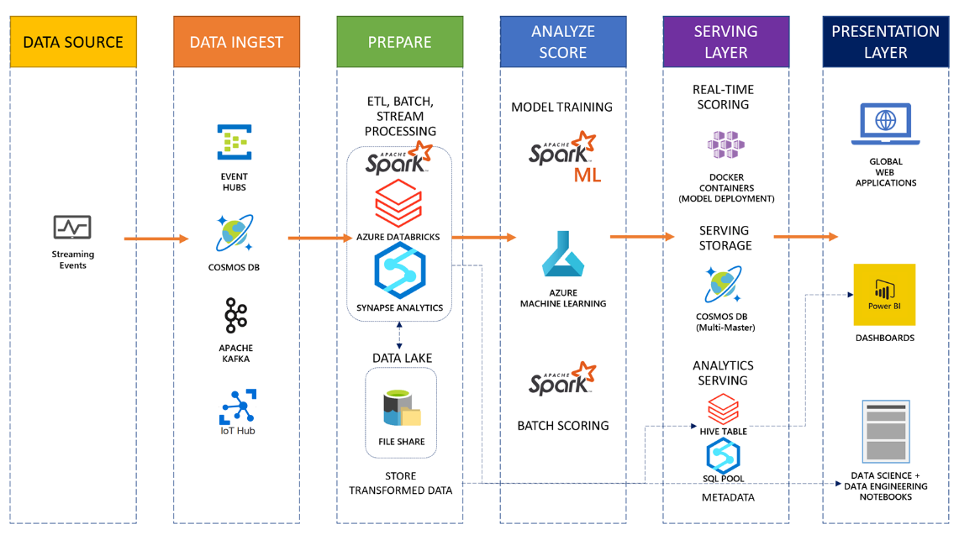
Common scenario

Slide 13
Step 2: Design the solution
Outcome
Design a solution and prepare to present the solution to the target customer audience in a 15-minute chalk-talk format.
Timeframe
60 minutes
Business needs (10 minutes) | Respond to questions outlined in your guide and list the answers on a digital Whiteboard.
Design (35 minutes) | Design a solution for as many of the stated requirements as time allows. Show the solution on a Whiteboard.
Prepare (15 minutes) | Identify any customer needs that are not addressed with the proposed solution. Identify the benefits of your solution. Determine how you will respond to the customer’s objections. Prepare for a 15-minute presentation to the customer.

Slide 14
Step 3: Present the solution
Outcome
Present a solution to the target customer in a 15-minute chalk-talk format.
Timeframe
30 minutes (15 minutes for each team to present and receive feedback)
Directions
Pair with another table.
One table is the Microsoft team and the other table is the customer.
The Microsoft team presents their proposed solution to the customer.
The customer asks one of the objections from the list of objections in the case study.
The Microsoft team responds to the objection.
The customer team gives feedback to the Microsoft team.

Slide 15
Wrap-up
Outcome
Identify the preferred solution for the case study.
Identify solutions designed by other teams.
Timeframe
15 minutes

Slide 16
Personalization
Whiteboard Design Session – Preferred Solution

Slide 17
High Level Architecture
Overall, the solution will need to integrate data from the users at the e-commerce store and other sources into an event hub to ingest the streaming data. Then analytics will be used in combination with machine learning and offer logic to produce customized user offerings and dashboards.

Slide 18
Data Ingestion
For this solution, the ingestion of data will happen with the event hub capturing data from various streaming sources, and then filtered by Azure Stream analytics.

Slide 19
Data Pipeline Processing
For this solution, data will be filtered by Azure Stream analytics and utilize pre-built models within Azure Machine Learning for determining product affinity. These models can then utilize Logic Apps to create a workflow to present recommendations based on specific personas.

Slide 20
Dashboards and Reporting
The dashboards for this solution should allow the marketing team to make sure that personalized recommendations are driving results.

Slide 21
Governance and Policy
In addition to all of the tools to make the solution work, this solution must be implemented with governance and privacy of the user at the forefront of all of the data efforts.

Slide 22
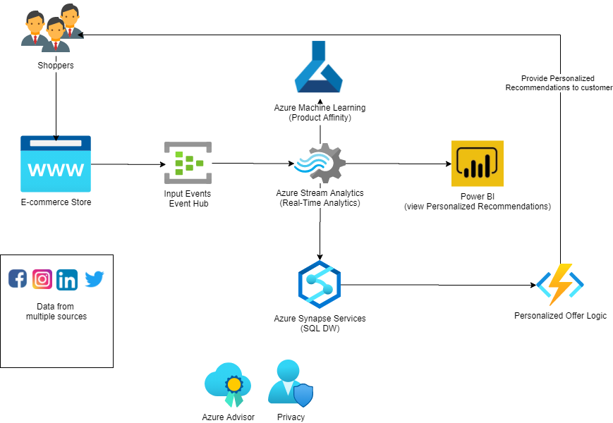
Preferred Solution Architecture diagram

Slide 23
Preferred objections handling #1
Objection
Our customer experience is fine the way it is. We currently have good reviews online. Calls to the customer service line are answered quickly and effectively. Isn't there a better way to spend our limited resources of time and money?
Potential answer
While you may currently have effective customer service, implementing this solution will allow your customer service reps to interact with your customers as if they know each other on a first-name basis. The situation will go from "a customer is calling" to "Jim is calling. Jim just purchased these products and has shown interest in these products. This is Jim's third call in the last week, and here is a log of Jim's last three calls."

Slide 24
Preferred objections handling #2
Objection
Our customer loyalty is very high - it's why we are able to stay in business this long. Will this hurt our customer loyalty or our brand image?
Potential answer
You will not lose your loyal customers by implementing these changes. It can be anticipated that your loyal customers will be even more pleased with the new solutions, and you will gain more loyal customers while reducing your customer churn.

Slide 25
Preferred objections handling #3
Objection
How do we ensure that the customer data we are tracking and keeping is not violating any privacy laws? Our concern here is that if we are breached, we could be facing a very serious lawsuit.
Potential answer
This is an important concern. By using Azure governance and implementing governance in your solutions, you can be assured that you are taking the appropriate actions to protect customer data and prevent any potential lawsuits from having merit against your company.

Slide 26
Preferred objections handling #4
Objection
How will using this solution provide the ability to offer products a customer might like? I am certain that our retail workers know their customers better than any algorithm ever could.
Potential answer
While a few of your customers and workers may have great relationships (that's awesome), even your best retail work likely doesn't know all of their customers and certainly doesn't know all of any customer's search history and habits. This solution will be able to use the data from analytics and machine learning to garner insights even your best retail workers could not have foreseen.

Slide 27
Preferred objections handling #5
Objection
It is hard to believe that the insights generated by this solution will be able to provide better marketing campaign ideas and targets than our seasoned marketing team that knows who our customers are and what they like.
Potential answer
This is similar to the previous objection, only this is interesting because it assumes that a human marketer has a better idea of how to present the data in the right way to the right people. Again, the marketer does have valuable insight into what works, and they can use the data to help make decisions. With machine learning and massive amounts of data, the system will aid the marketer to ensure that all possible avenues are explored to maximize ROI.

Slide 28
Customer Quote
"We are so pleased with the results offered through the provided solution. We have truly achieved a 360 degree view of our customers. We now have the ability to get feedback from the users and the ability to offer a more customized shopping experience. Our loyal customer base has increased two-fold since this solution has been implemented, and our customer churn is greatly reduced."
- Guy Information, CIO, Parts Unlimited Retail

